Slide 1
Open Targets: integrating genetics genomics and drug information for translational research and drug discovery
July 29th 2020
Denise Carvalho-Silva, PhD
EMBL-EBI | Open Targets
Wellcome Genome Campus
United Kingdom

Slide 2






The logistics for the next hour
‘Materials’ section: presentation.pdf
muted
Take questions at the end: look for the chat box!

Slide 3

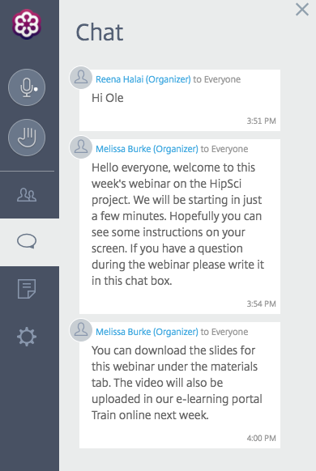
Chat box
Please enter your question into this box
Address chat to ‘Everyone’

Slide 4

What will I get out of this session?
Open Targets?
What is it?
What is the
Open Targets Platform
How can I make
the most of it?
How to get in touch
with the team?

Slide 5
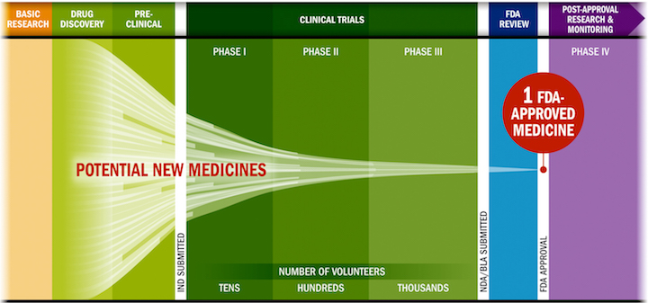
Drug discovery: some challenges
Lengthy, costly, low success rate, HIGH ATTRITION RATES
Source: PhRMA adaptation based on Tufts CSDD & School of Medicine, and FDA

Slide 6
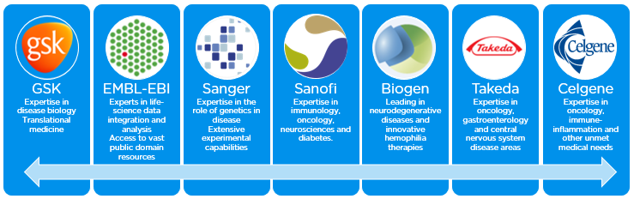
Open Targets
A partnership to transform drug discovery
Founding partners
2018
2016
2017
2018
Systematic identification and prioritisation of drug targets

Slide 7
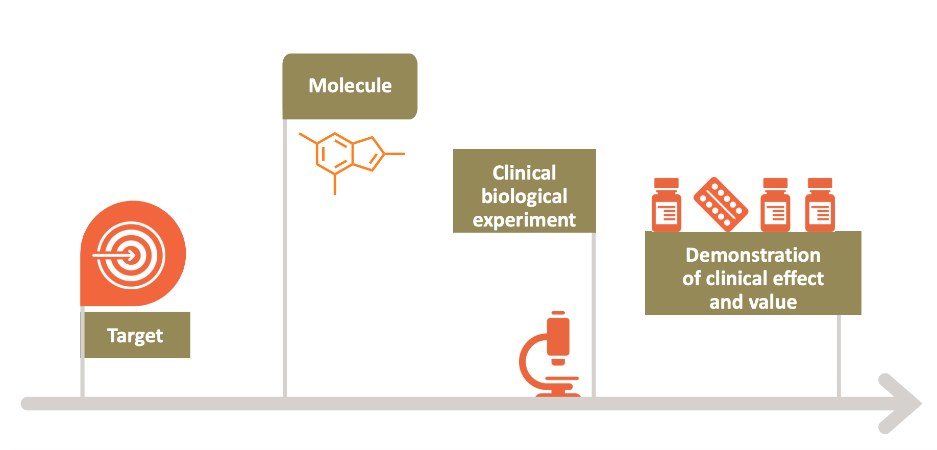
Selecting the right target

Slide 8




Knowledge cycle
Public data
Experimental
projects
Informatics
projects
DATA
GENERATION
DATA
INTEGRATION
Therapeutic hypothesis

Slide 9
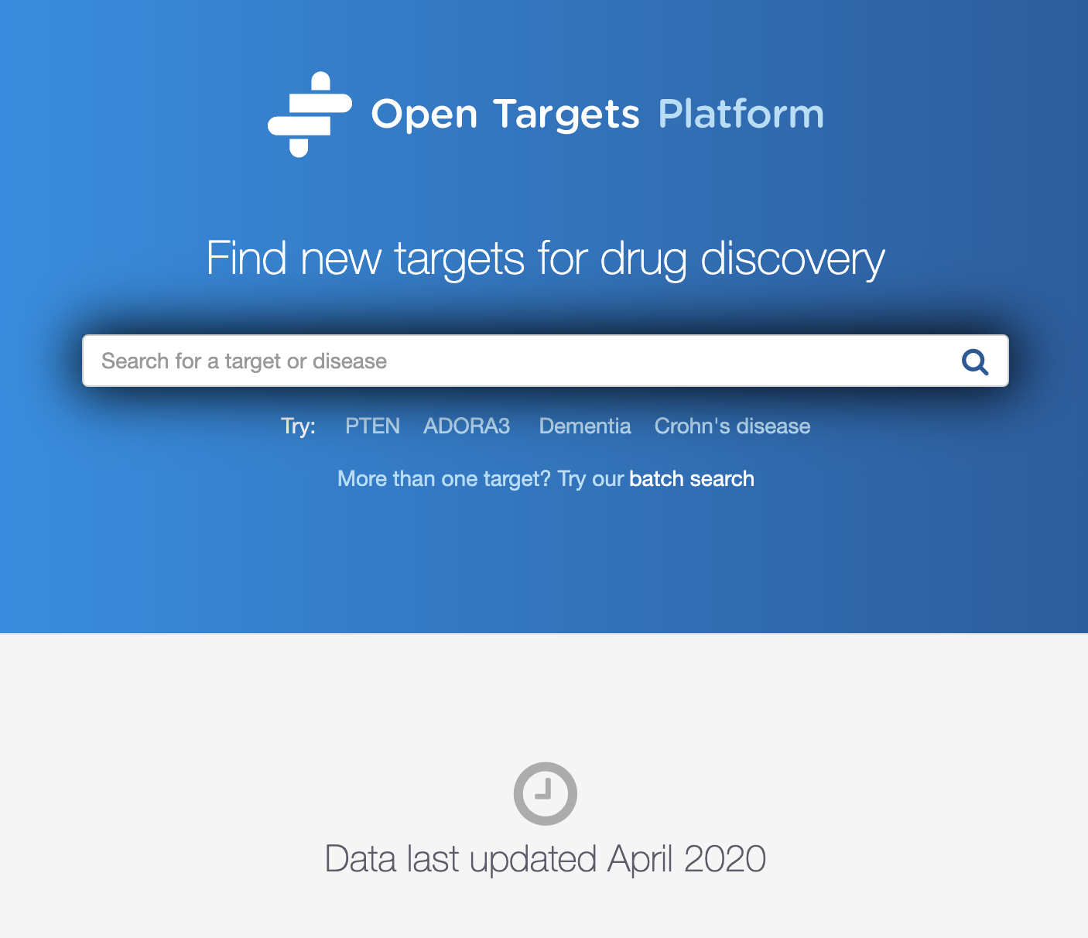
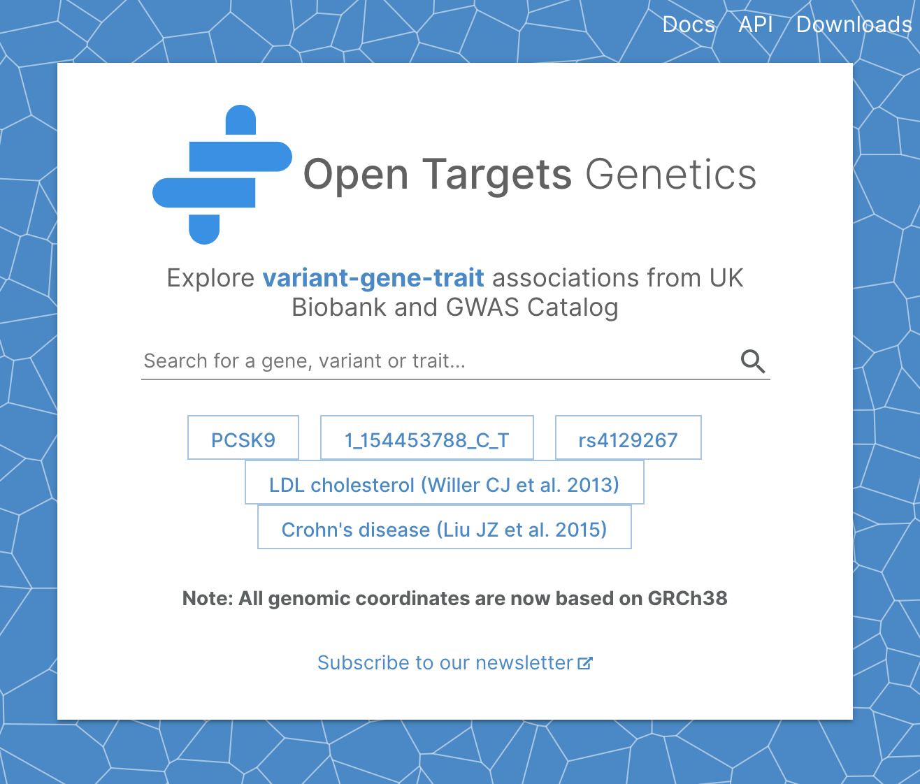
Informatics projects: flagships
https://www.targetvalidation.org
https://genetics.opentargets.org
This webinar

Slide 10

What can you do with the Open Targets Platform?
Target-disease associations (+ evidence + score)
https://www.targetvalidation.org/evidence/ENSG00000077238/EFO_0000341
Target annotations
https://www.targetvalidation.org/target/ENSG00000077238
Disease annotations
http://www.targetvalidation.org/diseaset/ EFO_0000341

Slide 11
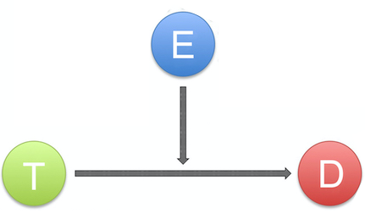
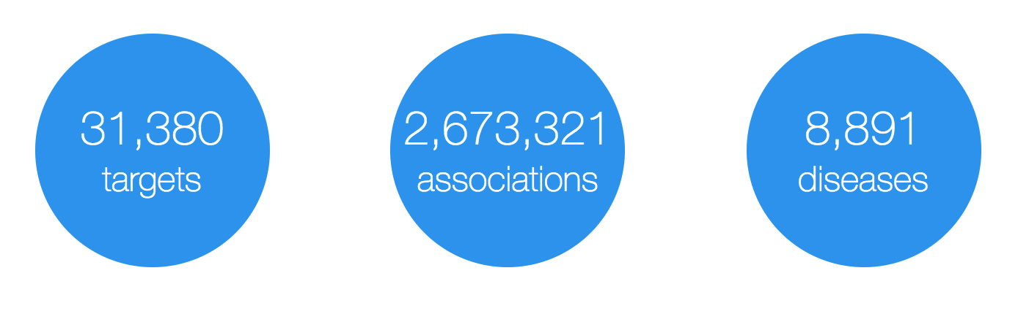
Data model
Evidence
(variants, drugs, literature, etc)
Target
(protein and non-protein coding genes)
Disease
(rare and common)

Slide 12
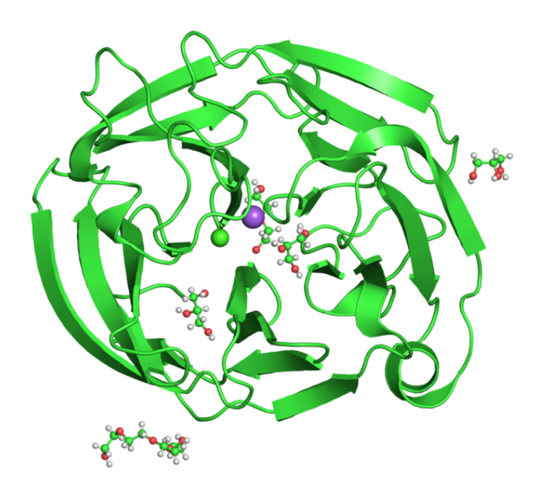
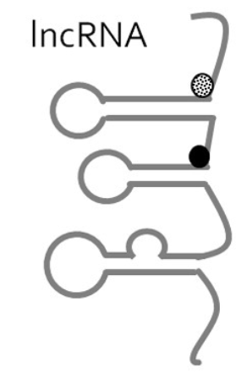
What is a target?
MYOC - glaucoma
(PDBe 4wxs)
Xist – Turner syndrome
(lncRNA)
27,596

Slide 13
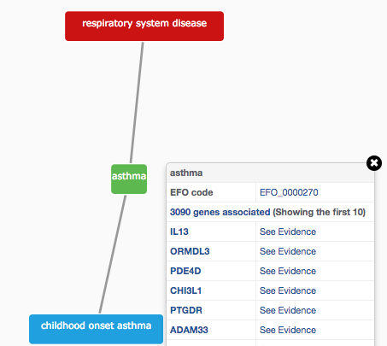
Describing diseases & phenotypes
Modified version of Experimental Factor Ontology v3 (EFO3)
Controlled vocabulary (Coeliac versus Celiac)
Hierarchy (relationships)
Promotes consistency
Increases the richness of annotation
Allow for easier and automatic integration
13,914

Slide 14
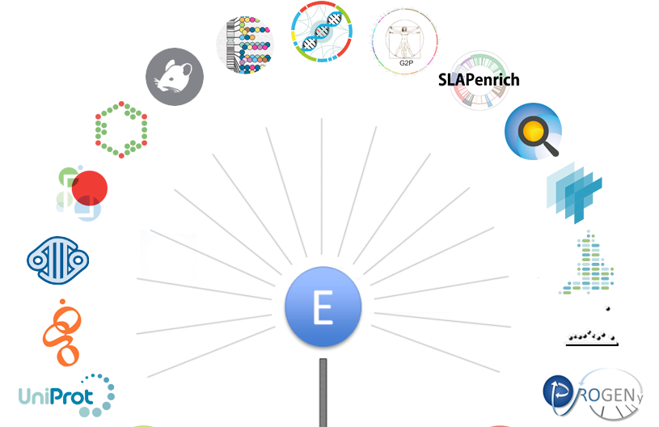
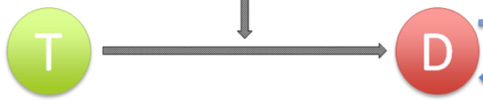
Evidence for target-disease associations
10,154,924
https://docs.targetvalidation.org/data-sources/data-sources

Slide 15
What can you do with the Open Targets Platform?
Target-disease associations (+ evidence + score)
https://www.targetvalidation.org/evidence/ENSG00000077238/EFO_0000341
Target annotations
https://www.targetvalidation.org/target/ENSG00000077238
Disease annotations
http://www.targetvalidation.org/diseaset/ EFO_0000341

Slide 17
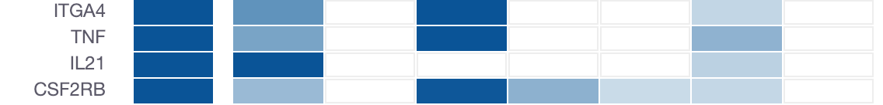
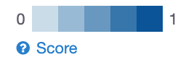
How well supported are the associations?
Association score to convey confidence
More evidence → stronger score
Different evidence are scored and weighted in different ways
Overall score
Genetic
Somatic
Drugs
Pathways
Expression
Text mining
Animal mod

Slide 18
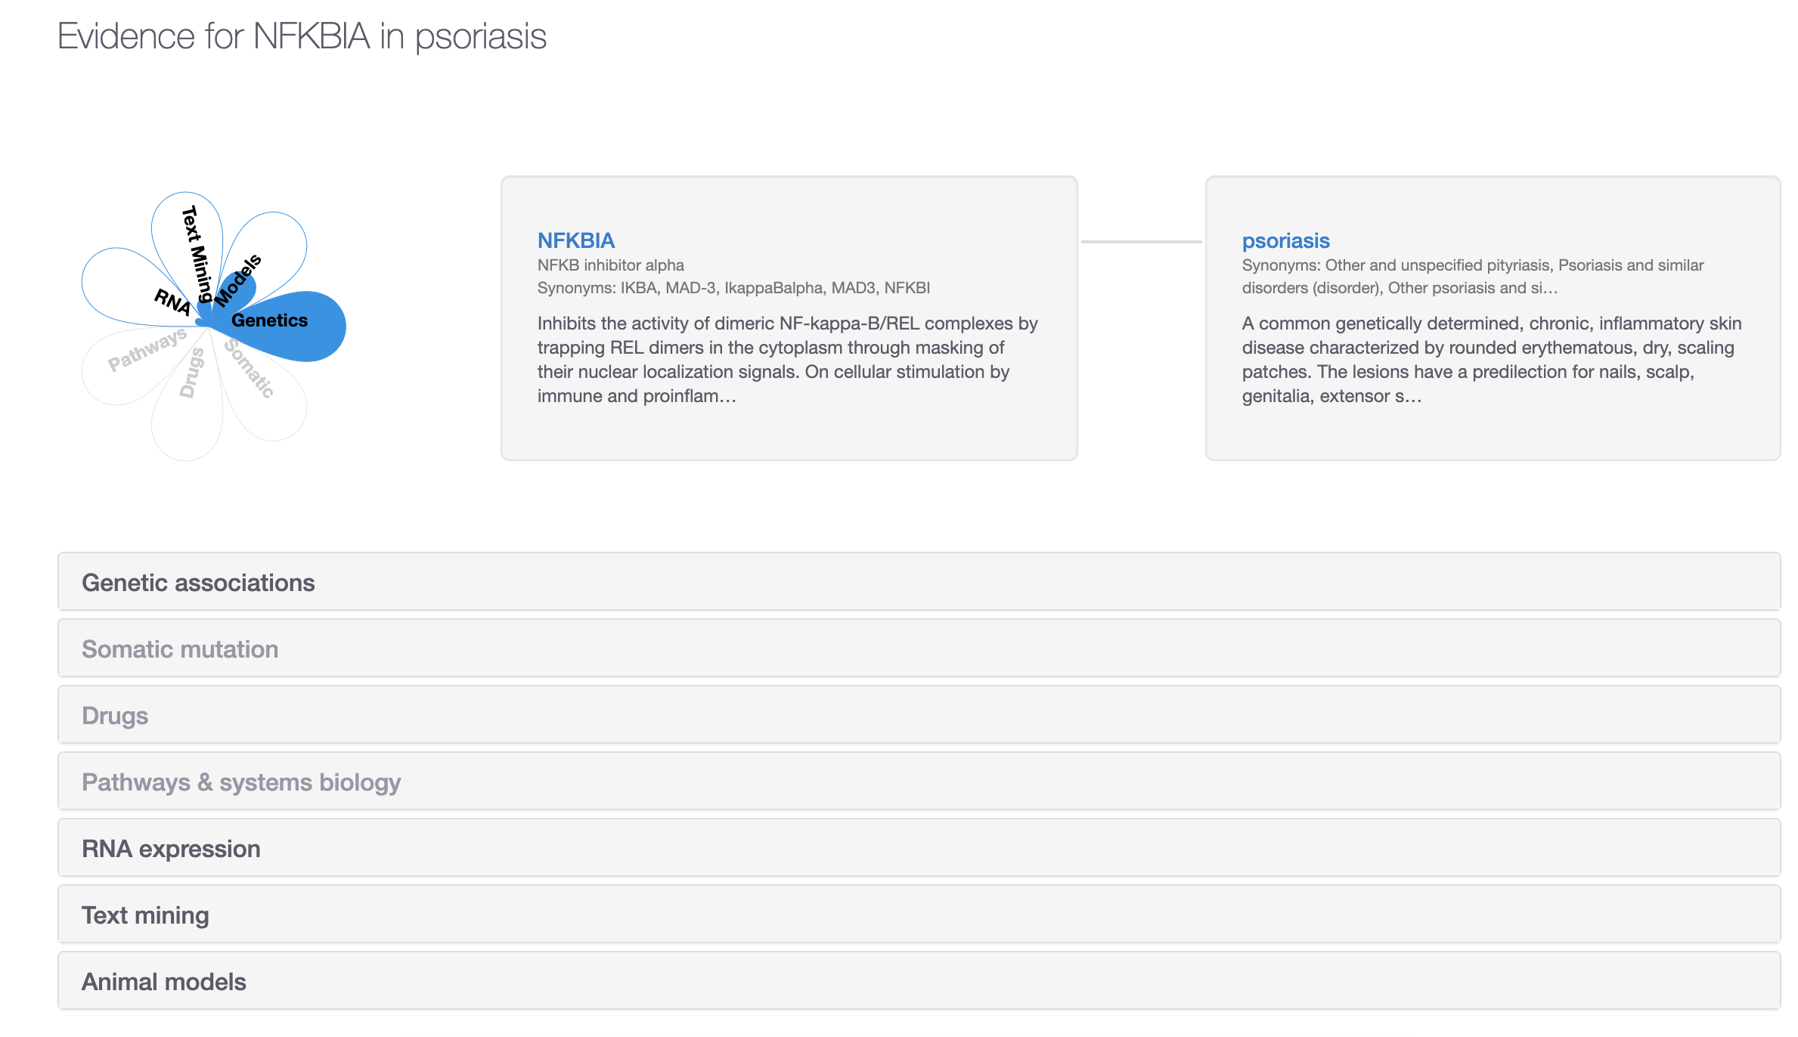
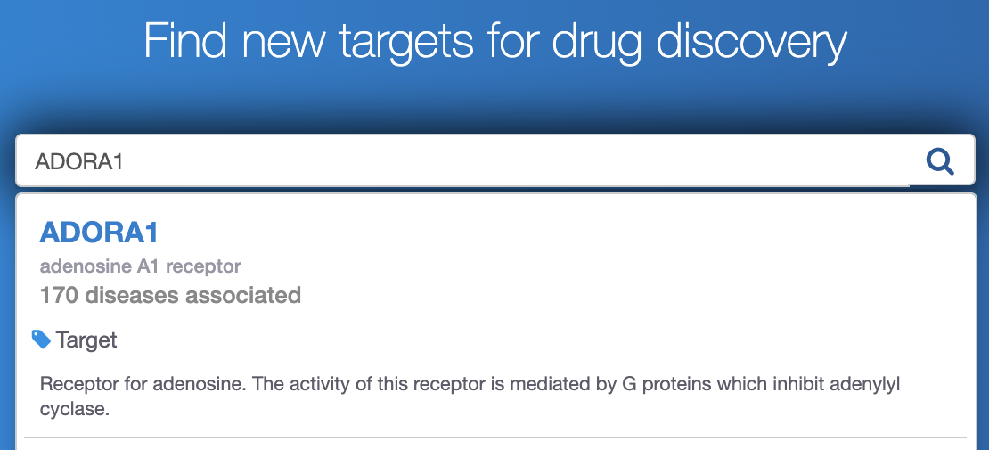
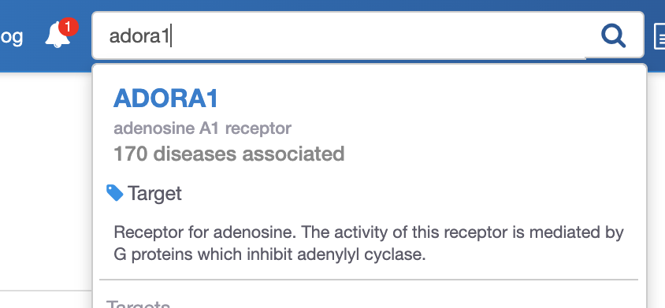
Demos 2 and 3
Target and disease annotations
Which diseases associated with my target?
Coursebook
pages 15-22
Coursebook
pages 22-24

Slide 19
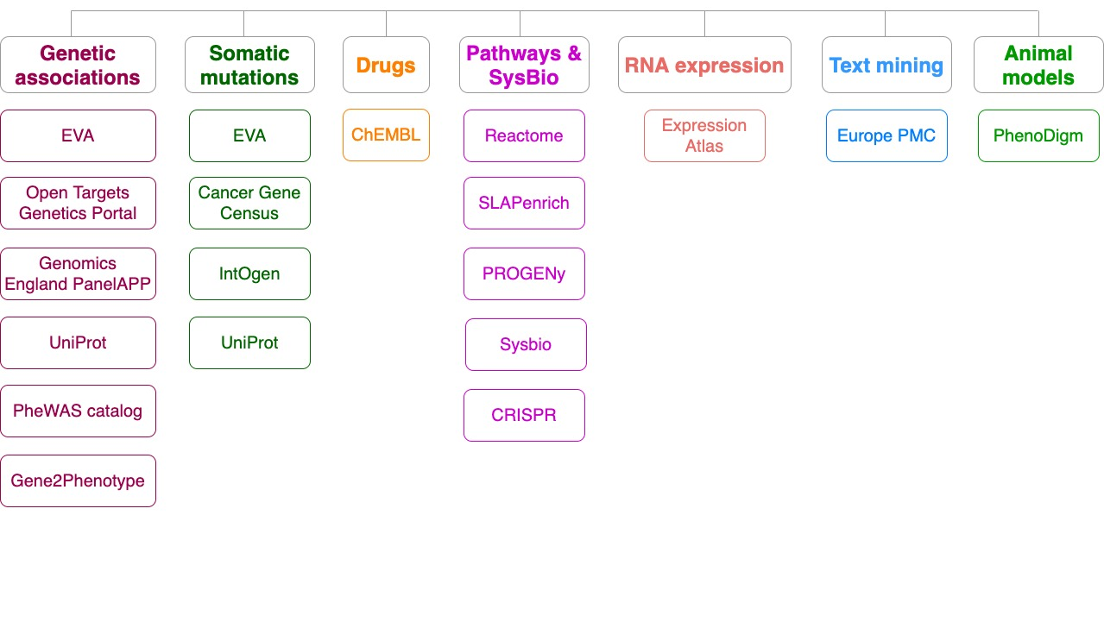
Data sources grouped into data types
> 7.2 M target-disease associations

Slide 20
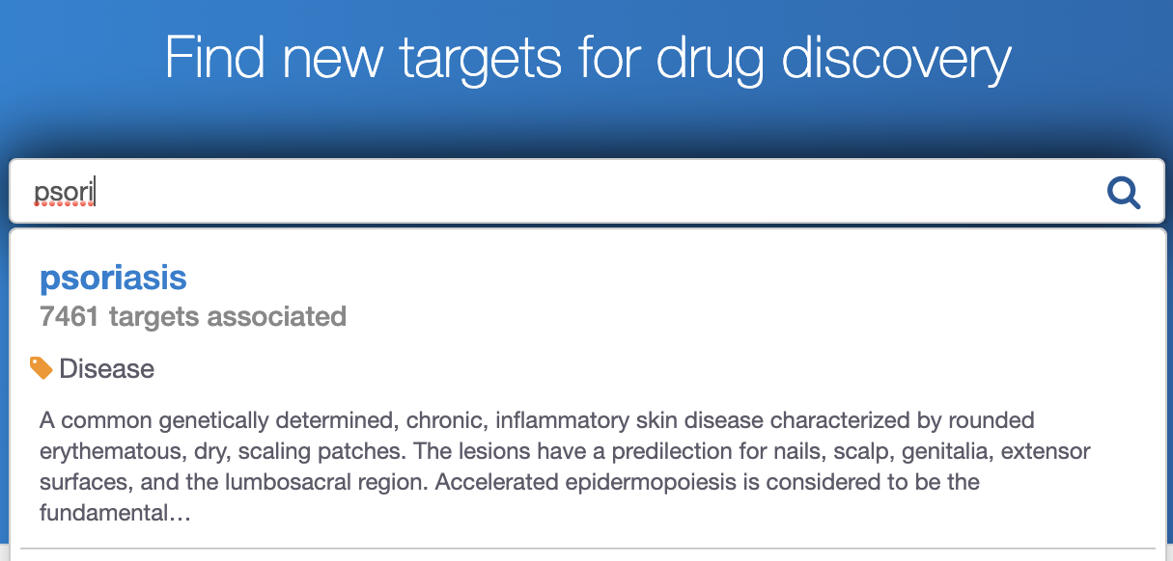
Live demo 1
Which targets are associated with my disease?
What is the evidence for the association?
Is there any data to help us to prioritise the list of associated targets?
Coursebook: pages 8-15

Slide 22
How well supported are the associations?
Association score to convey confidence
More evidence → stronger score
Different evidence are scored and weighted in different ways
Overall score
Genetic
Somatic
Drugs
Pathways
Expression
Text mining
Animal mod

Slide 23
Association score: 4-step computing
Aggregation and scoring using the harmonic sum
1) Evidence score (e.g. one SNP from EVA db)
2) Data source score (e.g. all SNPs from EVA db)
3) Data type score (e.g. all sources of Genetic associations)
4) Overall association score

Slide 24
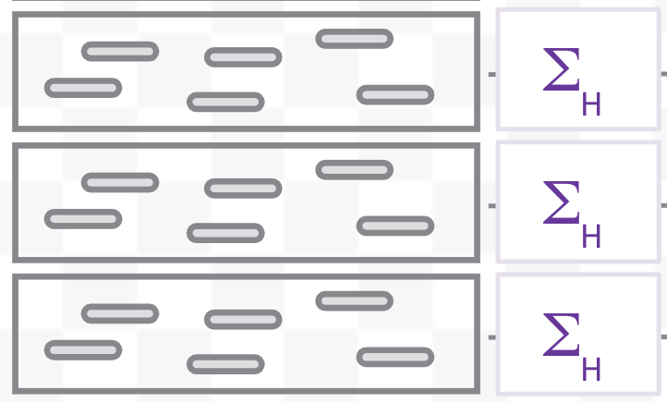
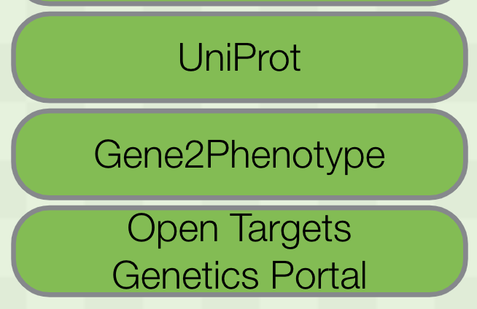
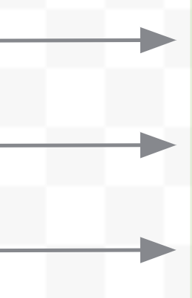
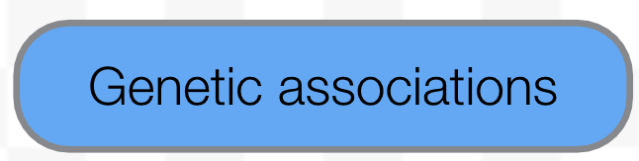
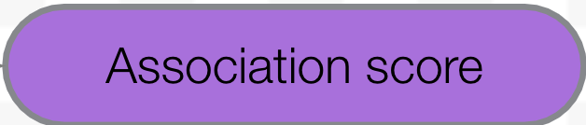
Harmonic sum
●
●
●
●
●
●
●
●
●
●
●
●
Aggregation

Slide 25
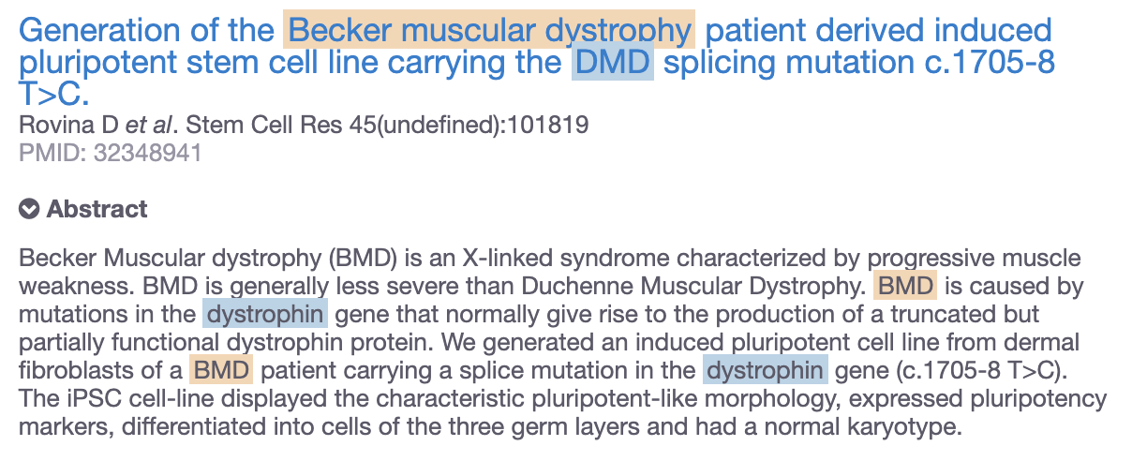
Factors affecting the evidence strength
Each data set has its own scoring and ranking scheme
e.g. text mining
https://docs.targetvalidation.org/getting-started/scoring

Slide 26
What can you do with the Open Targets Platform?
Target-disease associations (+ evidence + score)
https://www.targetvalidation.org/evidence/ENSG00000077238/EFO_0000341
Target annotations
https://www.targetvalidation.org/target/ENSG00000077238
Disease annotations
http://www.targetvalidation.org/diseaset/ EFO_0000341

Slide 27
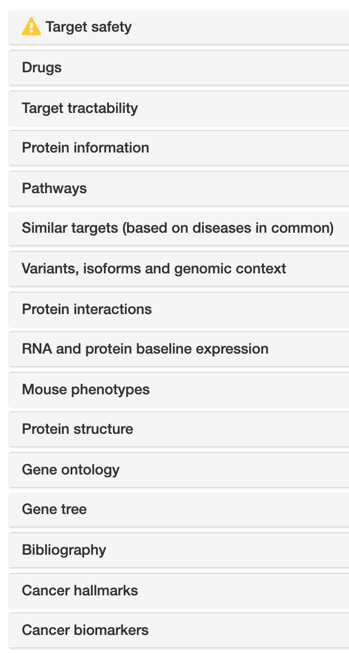
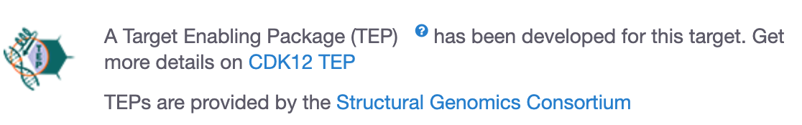
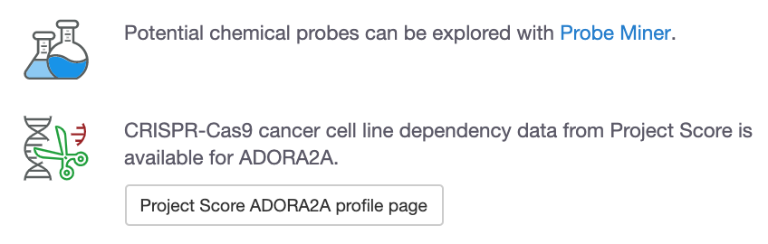
Target annotations
Target
profile page

Slide 28
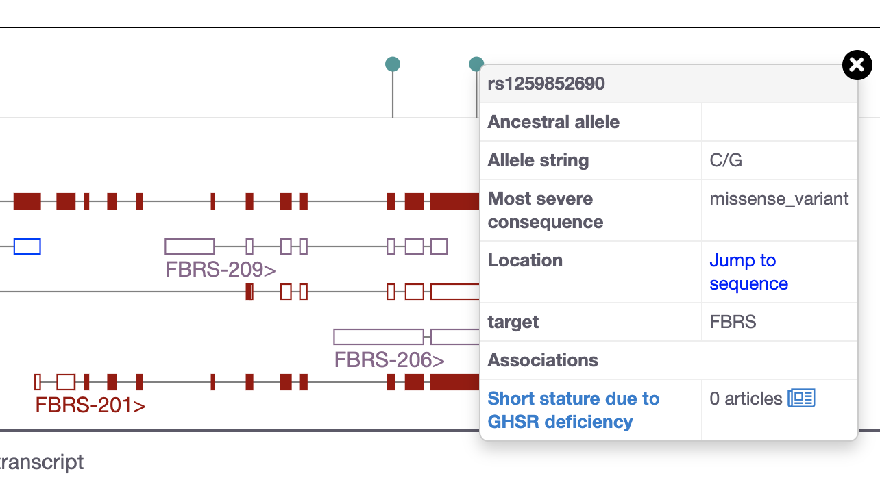
Does my target have disease-associated variants?
genome assembly: GRCh38 or hg38

Slide 29
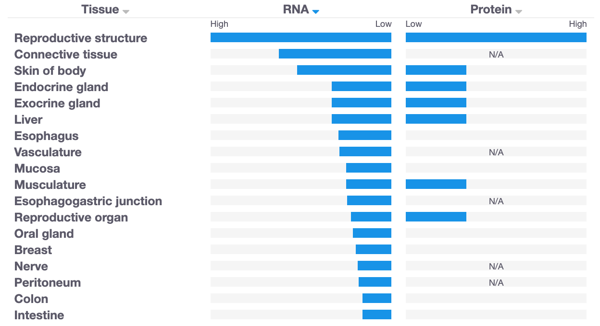
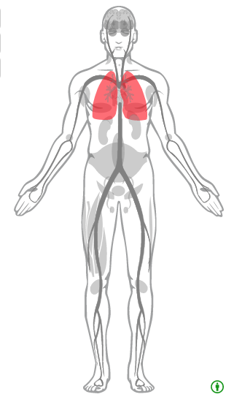
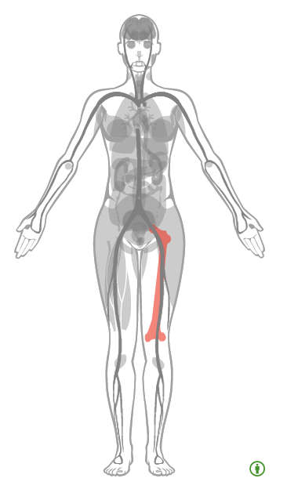
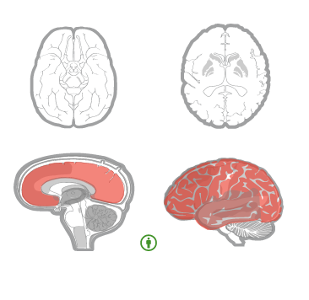
Is my target expressed in the relevant tissue?
* Images from Expression Atlas

Slide 30
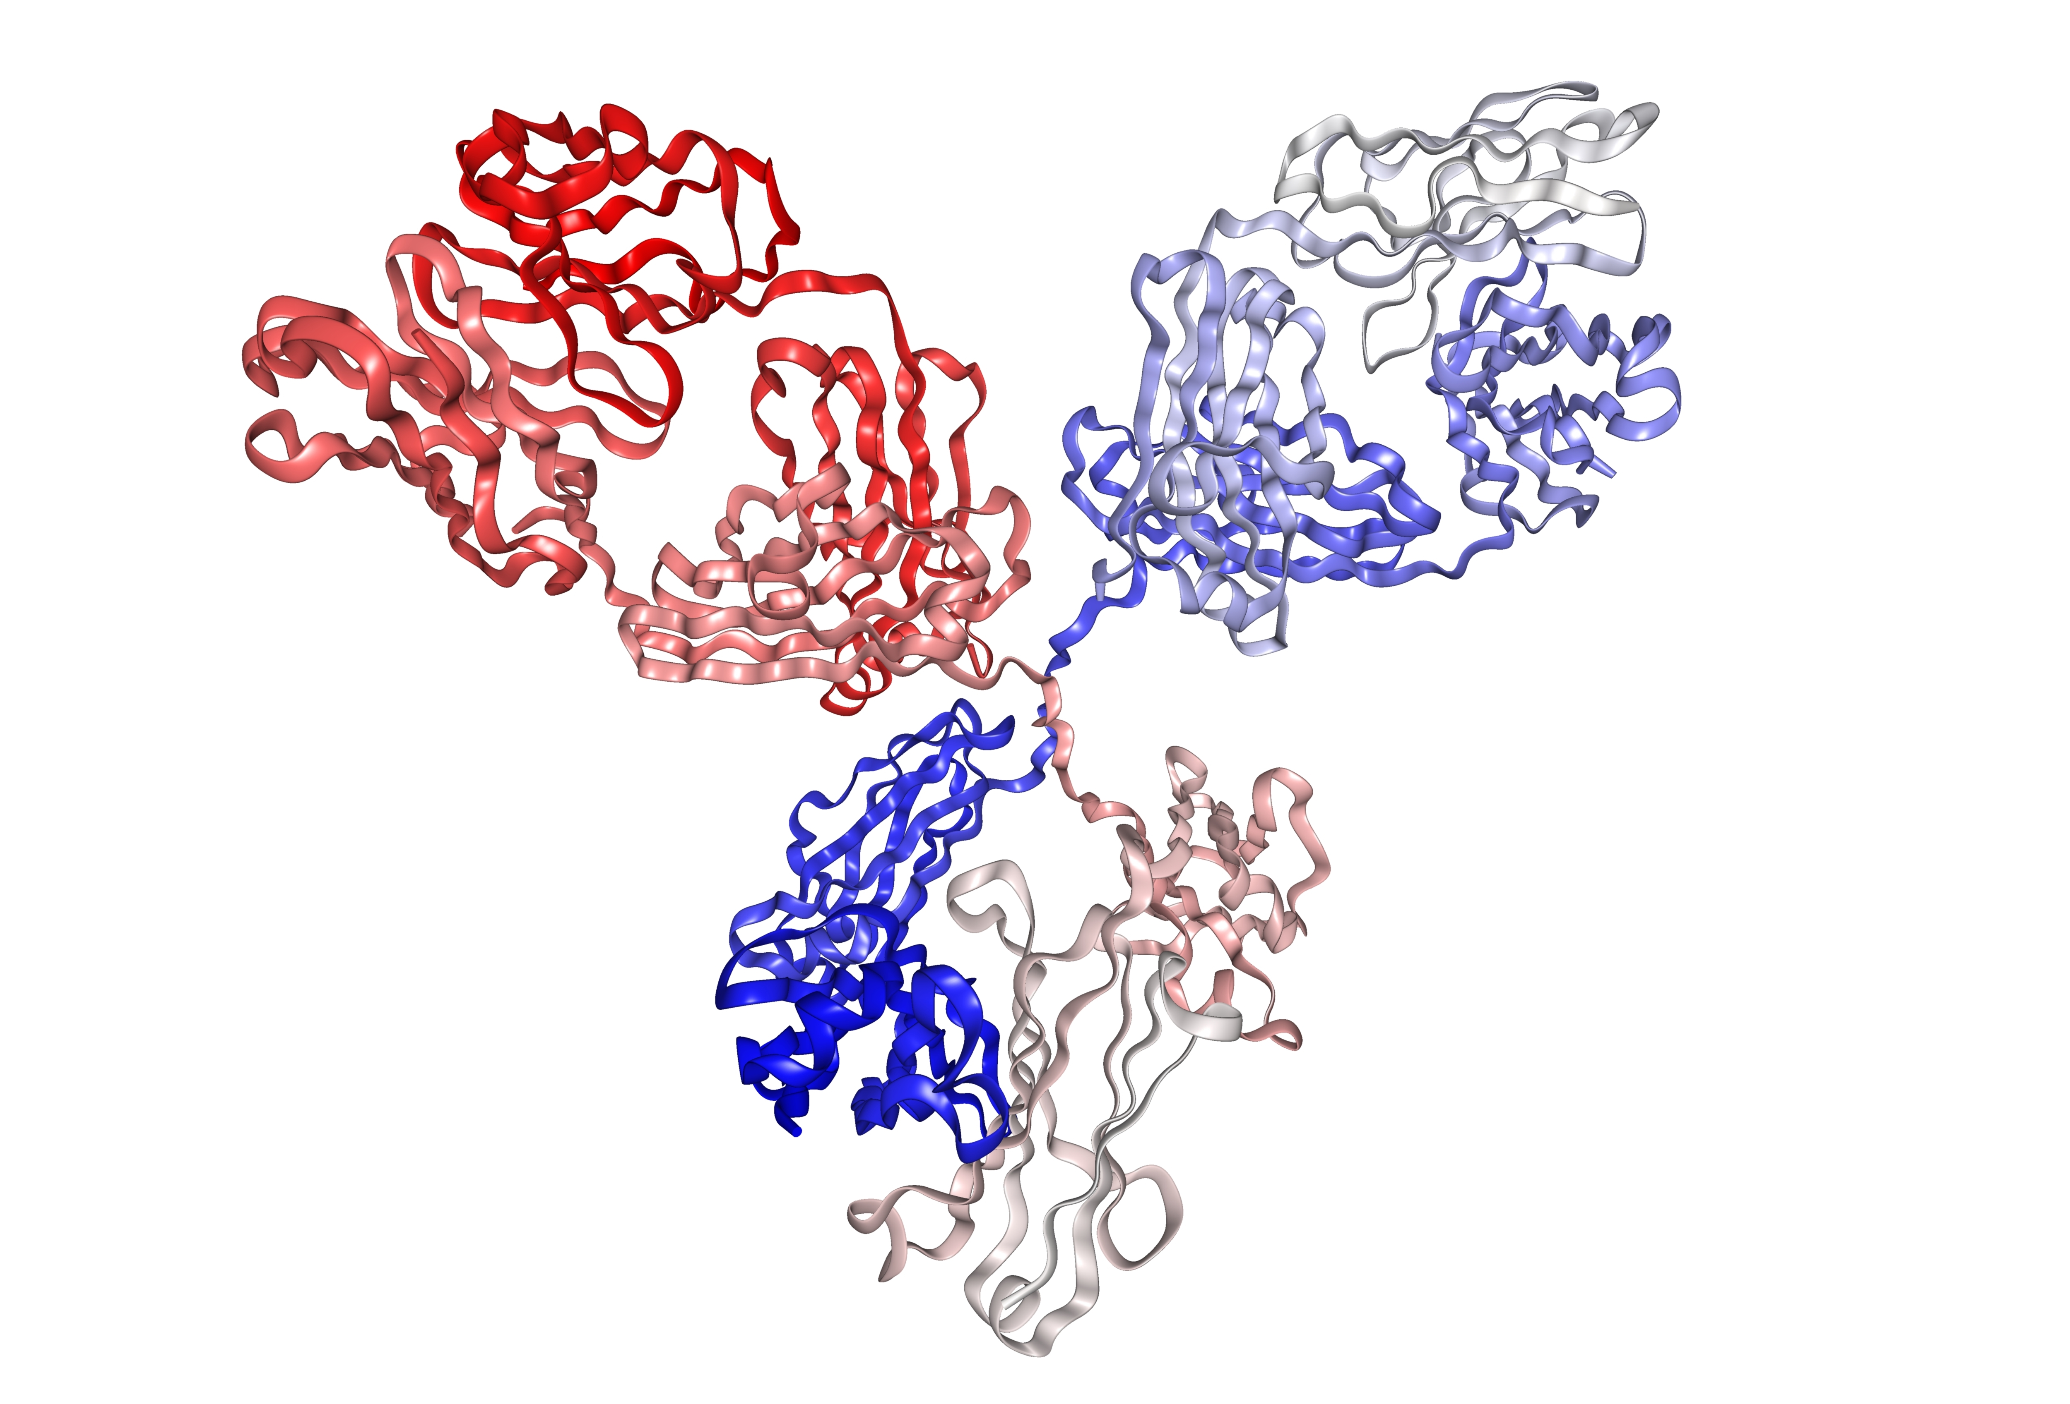
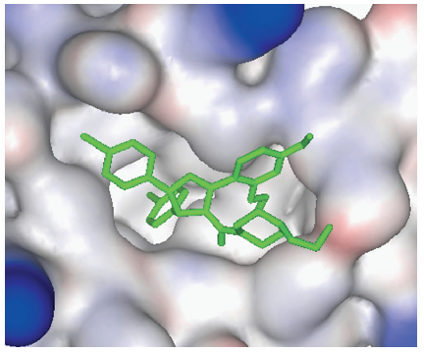
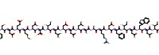
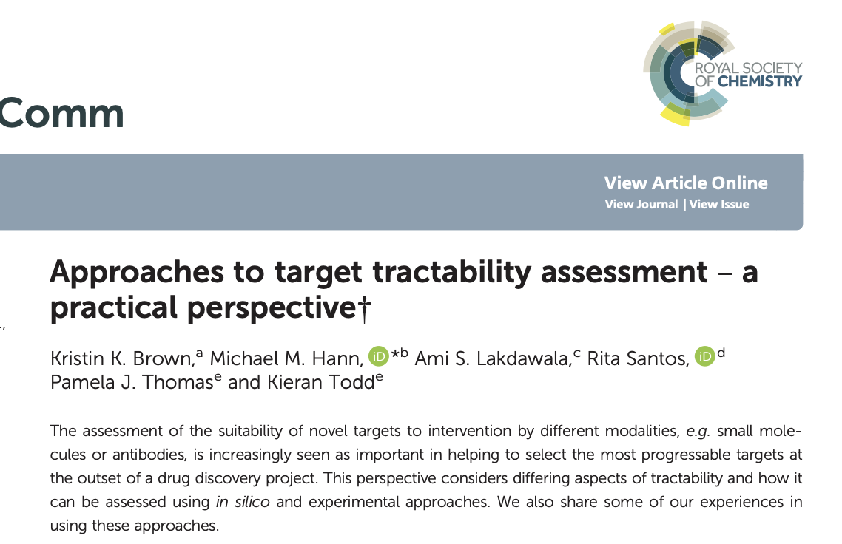
Is my target tractable?
Small molecule
DOI:10.1517/17460441.3.4.391
Antibody
https://www.immunology.org/structure-antibody-1972
Other
https://www.ebi.ac.uk/chembl/
compound_report_card/CHEMBL2104987/

Slide 31
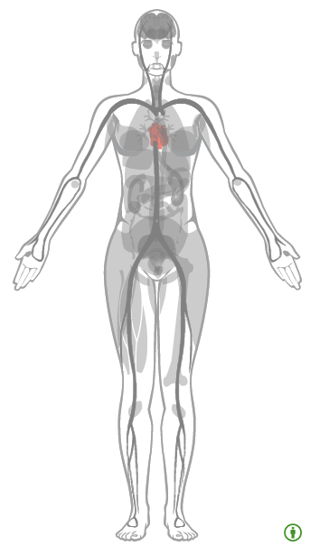
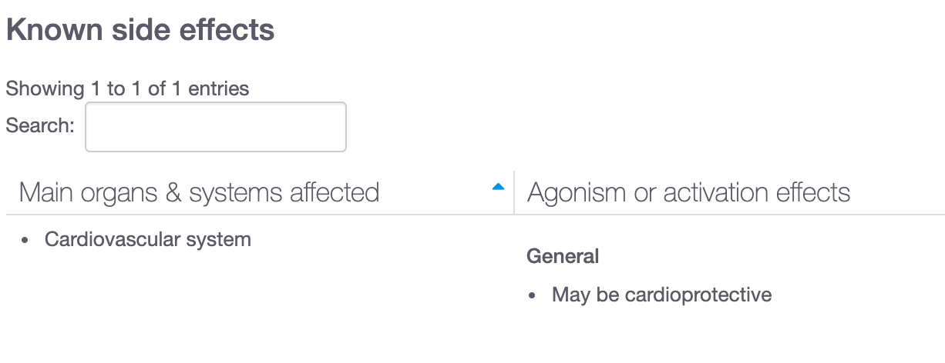
Is it safe to modulate my target?
Known side effects (e.g. convulsions for ADORA1)
Safety risk information (e.g. CV system for ATK1)
Non-clinical experimental toxicity
Data available for 439

Slide 32
What can you do with the Open Targets Platform?
Target-disease associations (+ evidence + score)
https://www.targetvalidation.org/evidence/ENSG00000077238/EFO_0000341
Target annotations
https://www.targetvalidation.org/target/ENSG00000077238
Disease annotations
http://www.targetvalidation.org/diseaset/ EFO_0000341

Slide 33
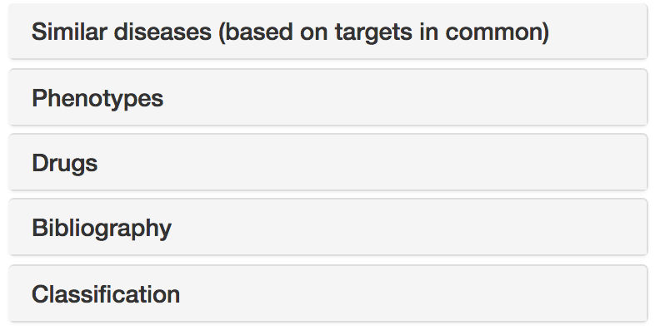




Disease annotations
Disease profile page
https://docs.targetvalidation.org/getting-started/getting-started/disease-profile

Slide 34
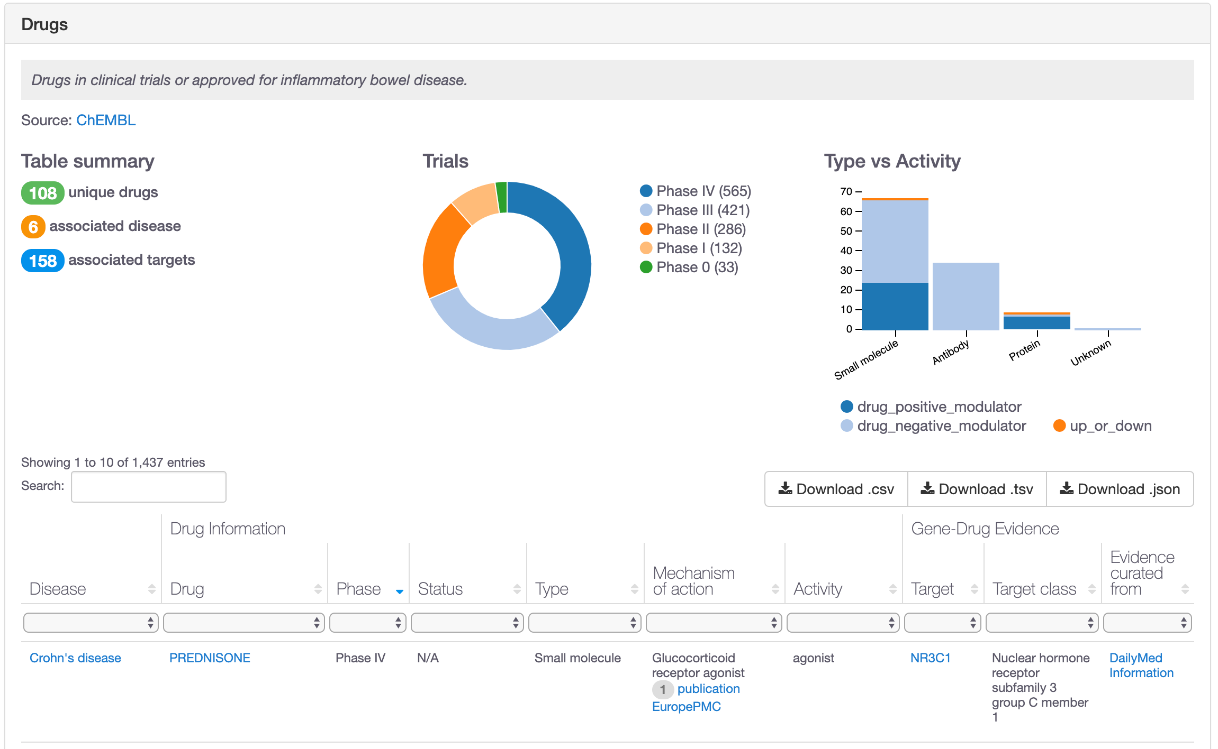
Which drugs are in clinical trials?

Slide 35
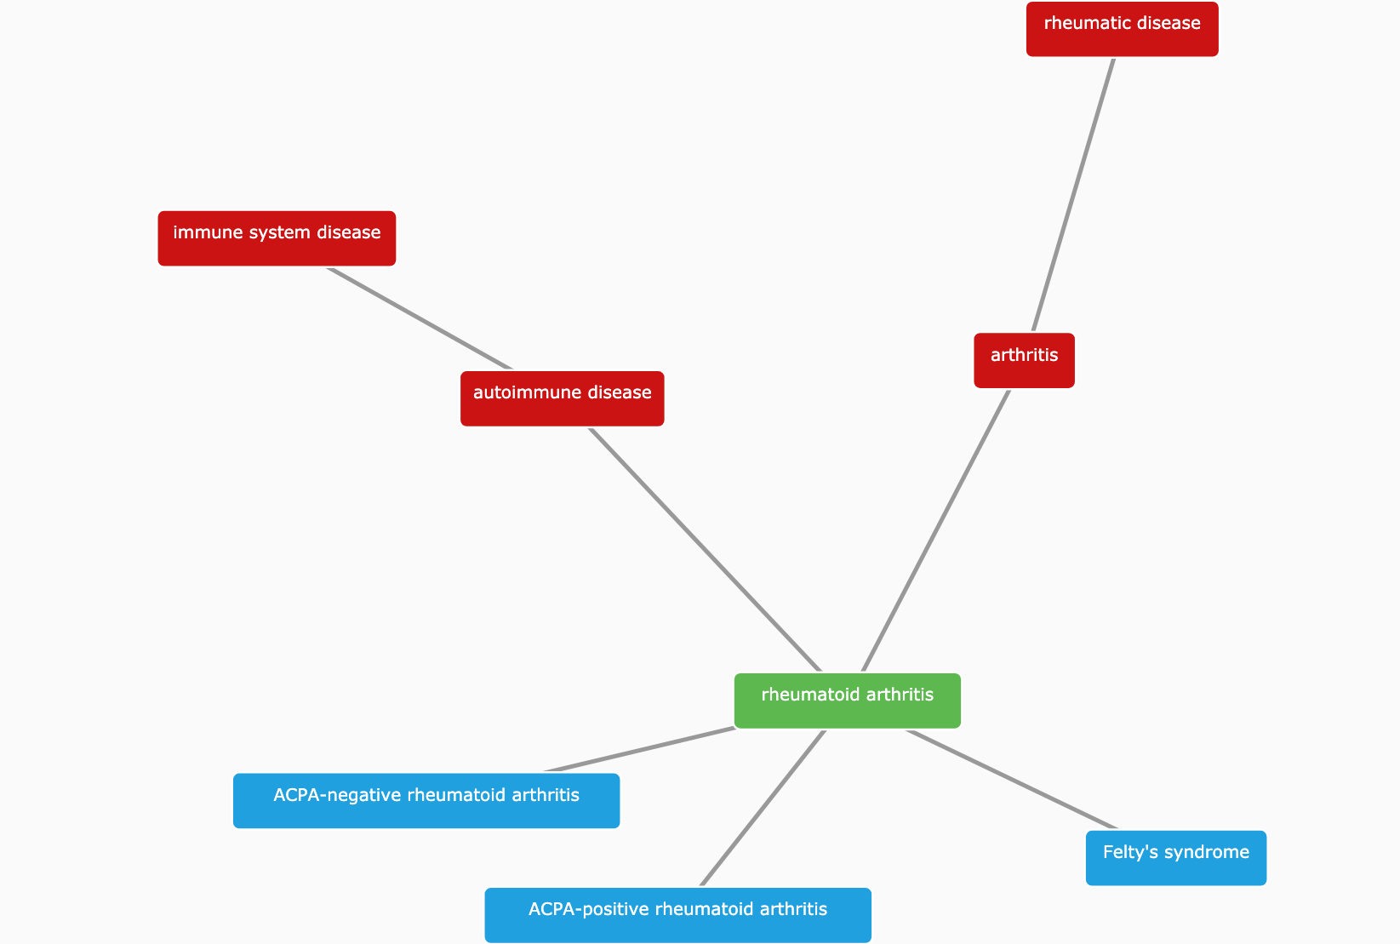
Which other diseases relate to my disease?
https://www.targetvalidation.org/disease/EFO_0000685

Slide 36
Demos 2 and 3
Target and disease annotations
Which diseases associated with my target?
Coursebook
pages 15-22
Coursebook
pages 22-24

Slide 37


Slide 38
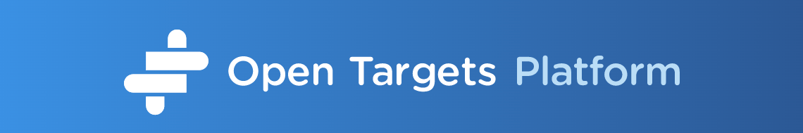
Exercises 1, 2 and 3
Pages 25-27

Slide 39
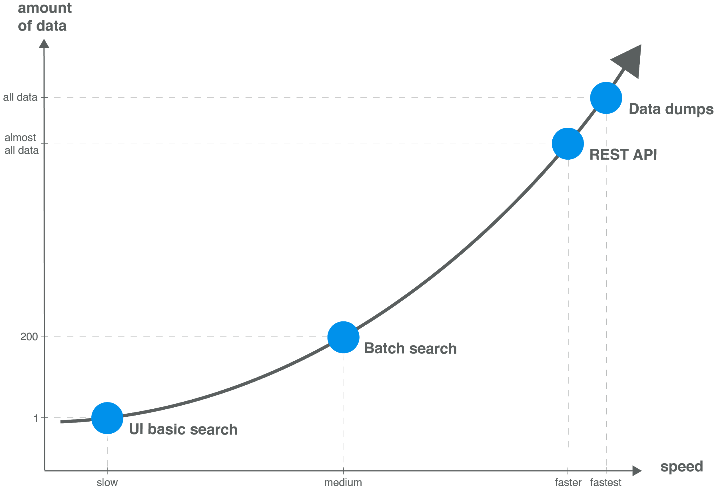
Modes of access → data volume

Slide 40
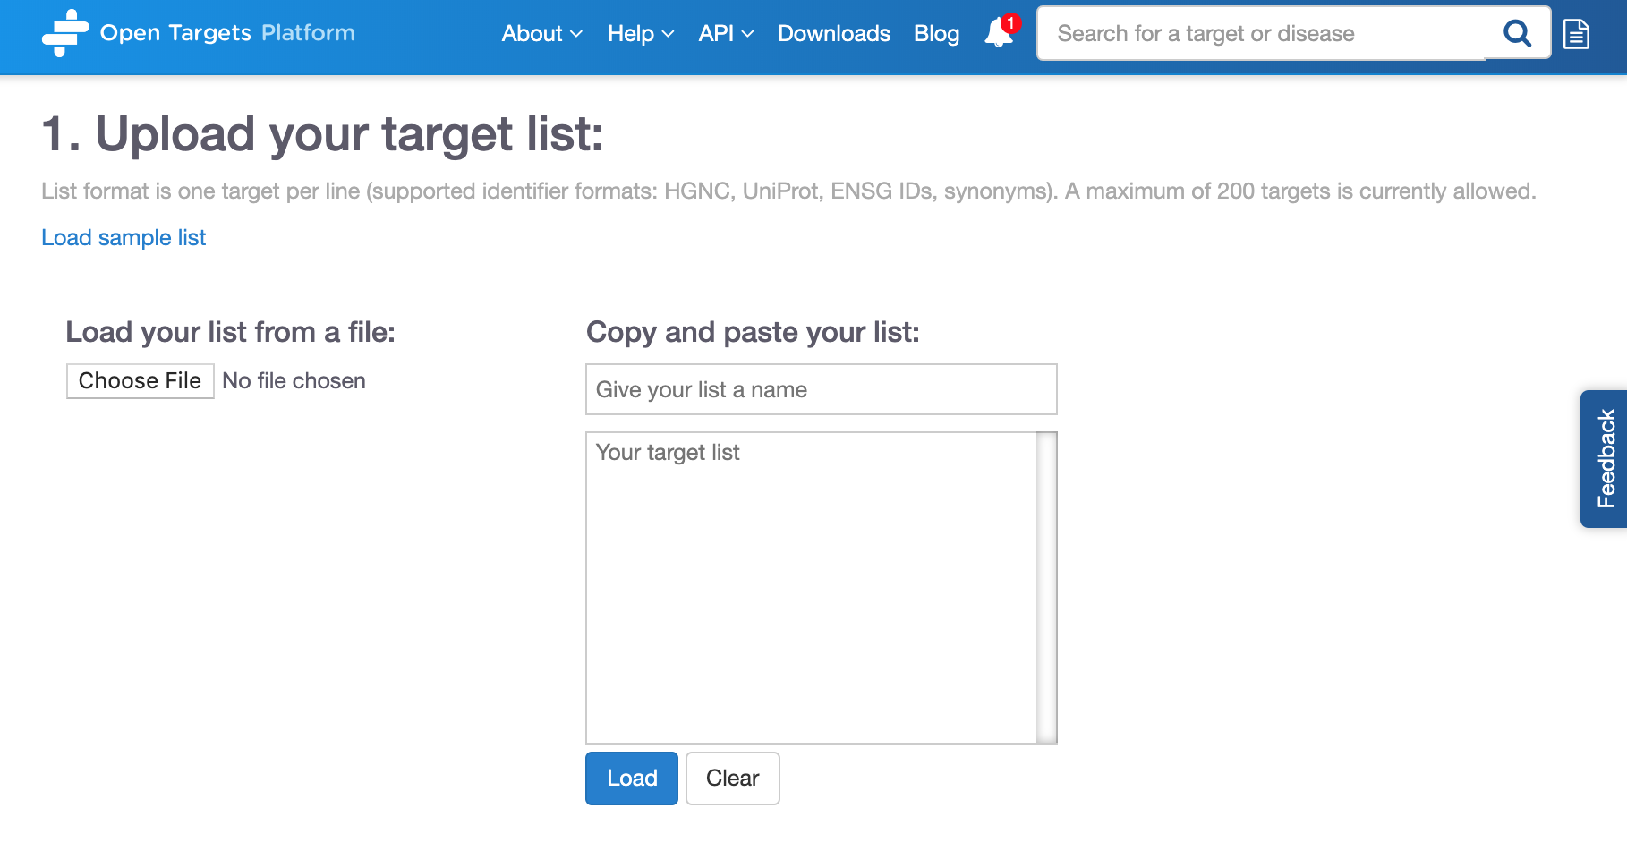
Batch search
https://www.targetvalidation.org/batch-search

Slide 41



Open Targets Platform REST API*
Server
https://platform-api.opentargets.io/v3/platform/
Endpoint
public/association/filter
Parameters
?target=ENSG00000163914&size=10000&fields=target.id&fields=disease.id
Open Targets Python client **
*
https://docs.targetvalidation.org/tutorials/rest-api
**
https://docs.targetvalidation.org/tutorials/python-client

Slide 42





Wrapping up
Public data
Experimental projects
Bioinformatics projects
DATA
GENERATION
DATA
INTEGRATION
Therapeutic hypothesis

Slide 43
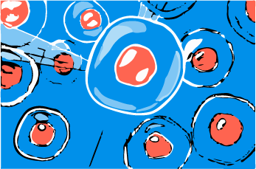
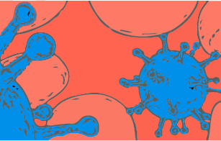

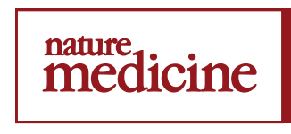




Data generation: therapeutic areas
8 ongoing projects
9 ongoing projects
3 complete projects
2 complete projects
13 ongoing projects
3 publications
3 publications

Slide 44
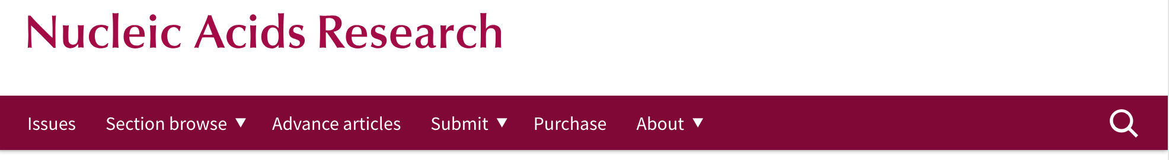

How to cite us
http://bit.ly/cite-us
https://www.targetvalidation.org

Slide 45

Join us!
https://www.opentargets.org/jobs

Slide 46


Happy to take questions!

